Slide 1

IS833 Team Project
Analysis of EV Adoption in Washington State
Team 5
Justin Gitelman
Minje (Lima) Kim
Su Min Tan
Raghav Verma
Pei-Chun (Paige) Yang

Slide 2
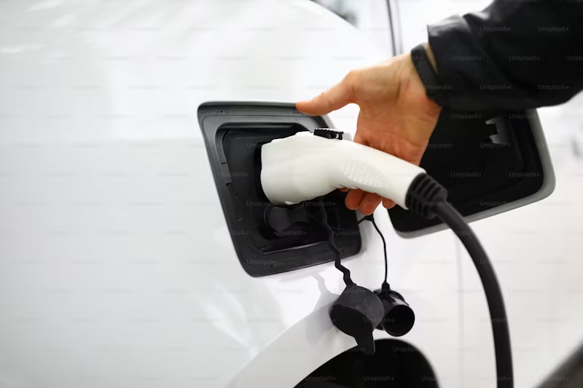
Project objective/proposal
Identify adoption trends of electric vehicles (EVs) across cities in Washington, and note patterns and insights that would enable key stakeholders such as EV manufacturers and the government to understand the market dynamics of the EV market and key infrastructure requirements that encourage adoption.
Examine the relationship between the adoption of EVs and the availability of various charging infrastructure across various cities.

Slide 3
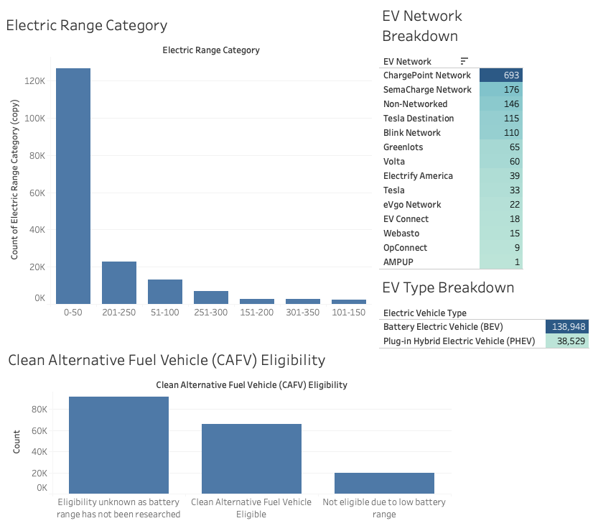
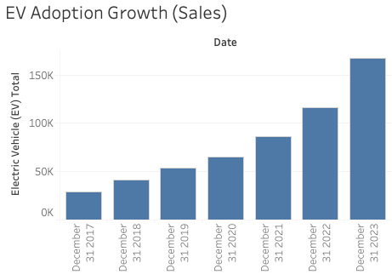
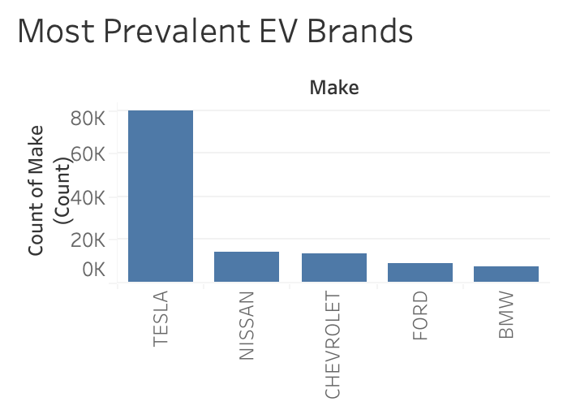
Understanding the EV Market
Dashboard Page 1
Dashboard Page 2

Slide 4
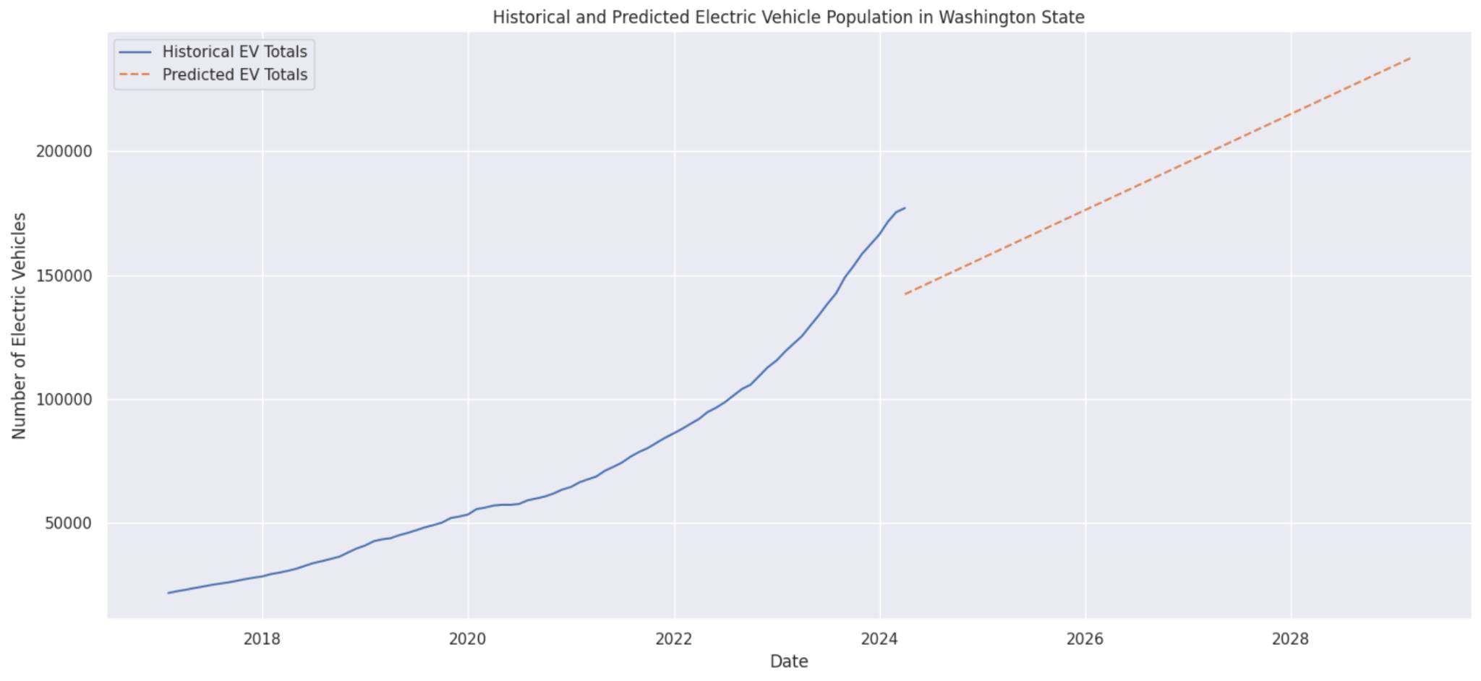
Historical & Predicted EV Growth
EV growth is increasing exponentially in the past two years, but the historical regression predicts a steady growth trajectory on track to double over the next decade.

Slide 5
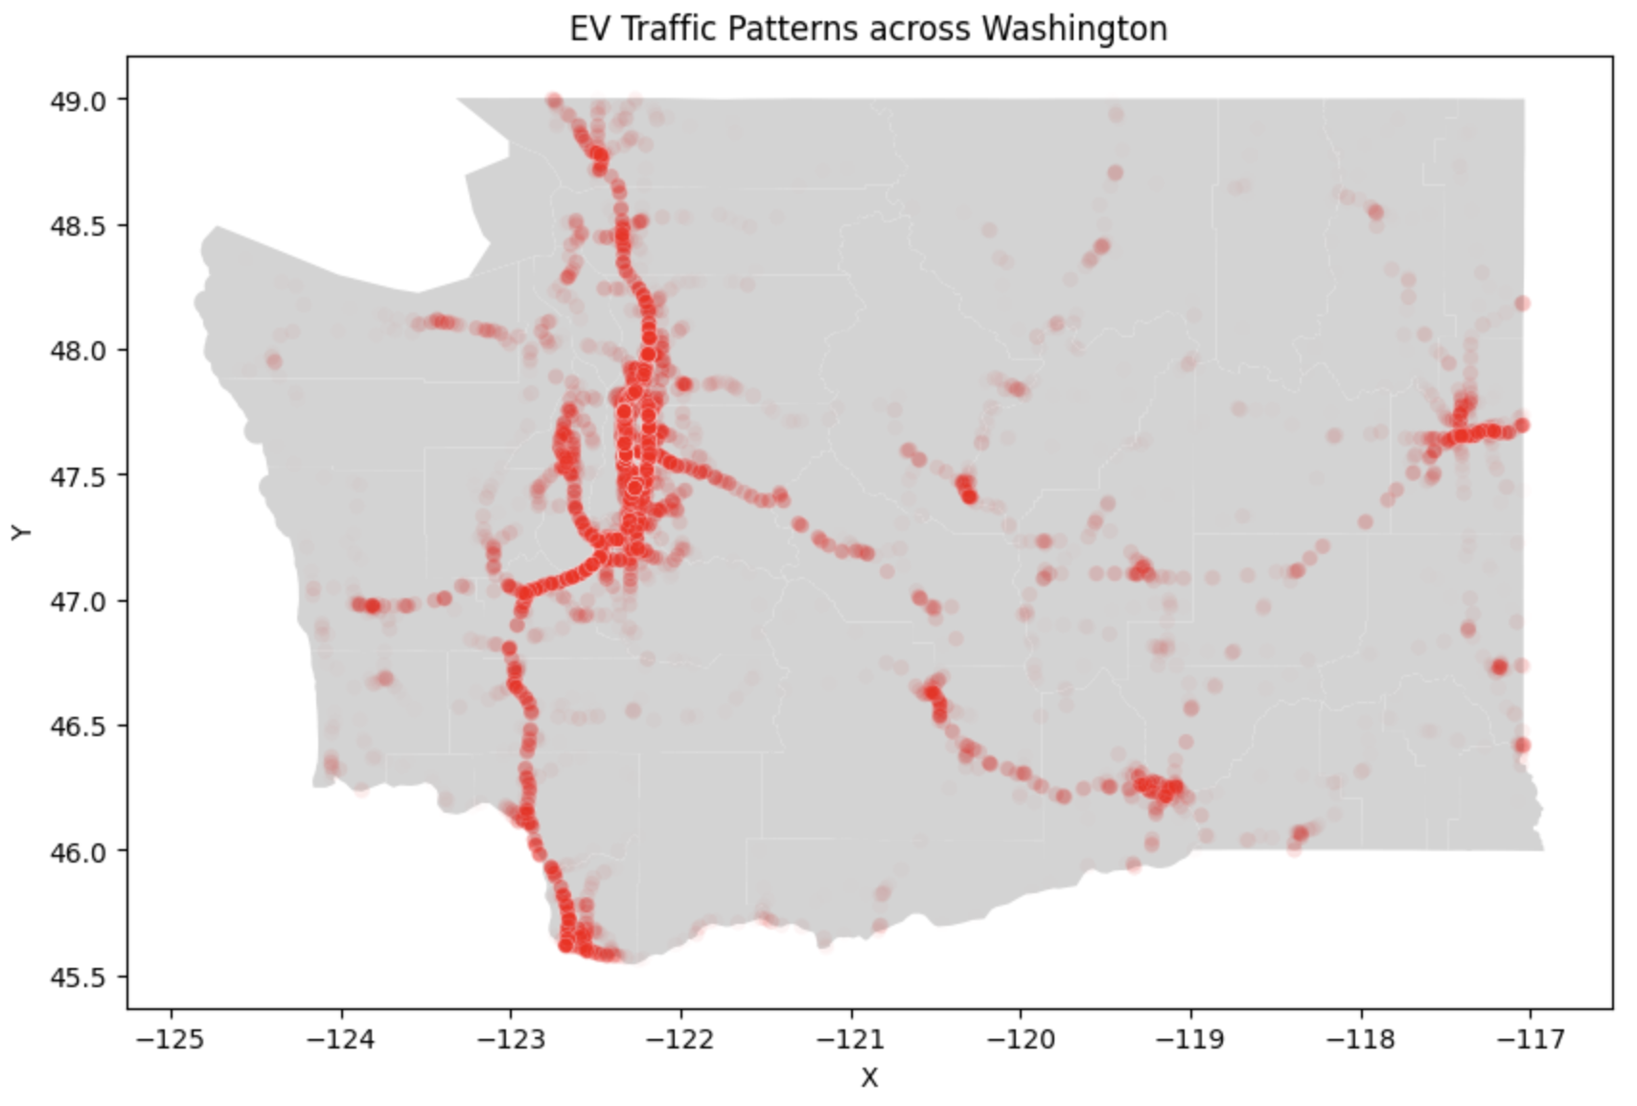
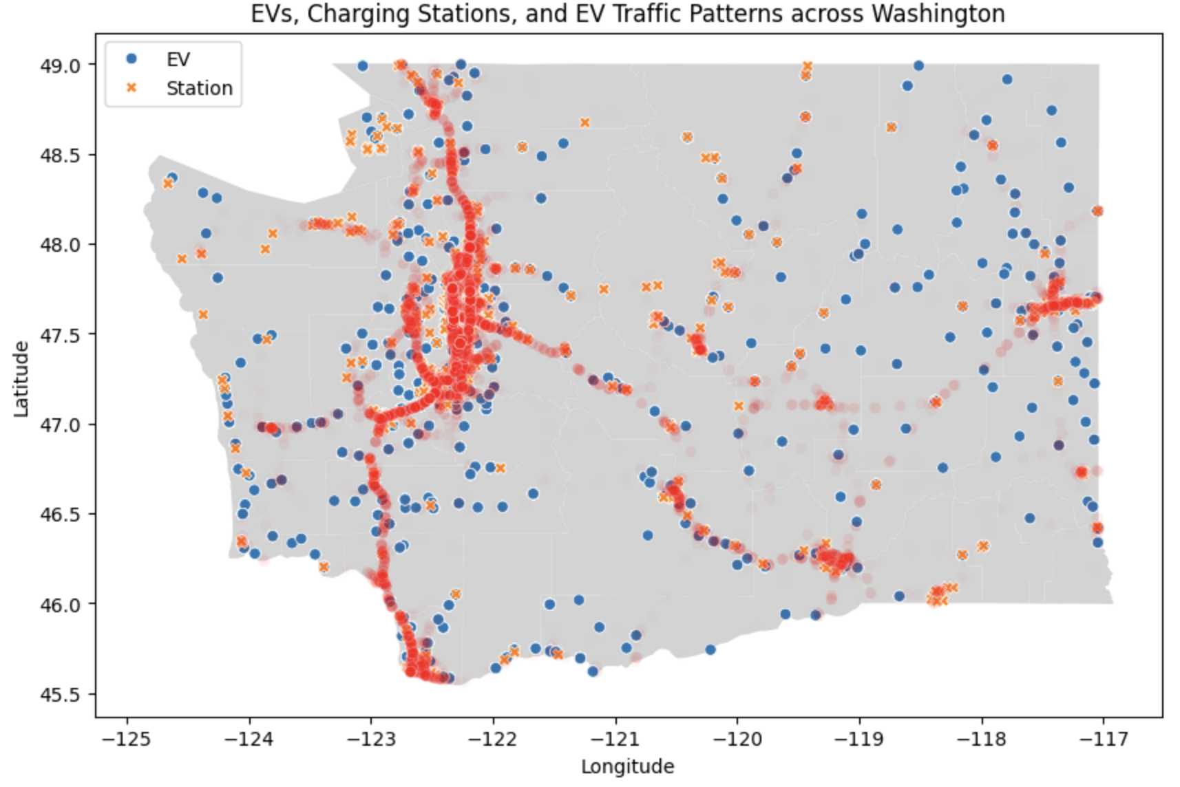
EVs, Charging Stations & EV Traffic Patterns
Most average daily traffic volume is concentrated around the major metro area of Seattle/Tacoma, WA as well as highways extending downward to Oregon and upward to British Columbia. While EV charging stations are plentiful around these concentrated areas, there are large gaps in the northeastern and southeastern quadrants where there is plenty of EV ownership relative to the low traffic areas but a small amount of EV charging stations.

Slide 6
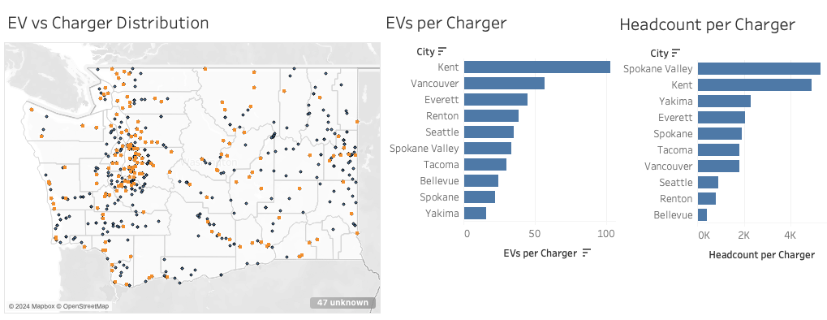

Infrastructure Deficit
More EVs per charger means more competition to find an open charger. Cities with high population such as Spokane Valley and Kent showcase deficits that are opportunities to add chargers. For example, despite having similar population, Kent has nearly three times the number of EVs sharing each charger.
Dashboard Page 1

Slide 7
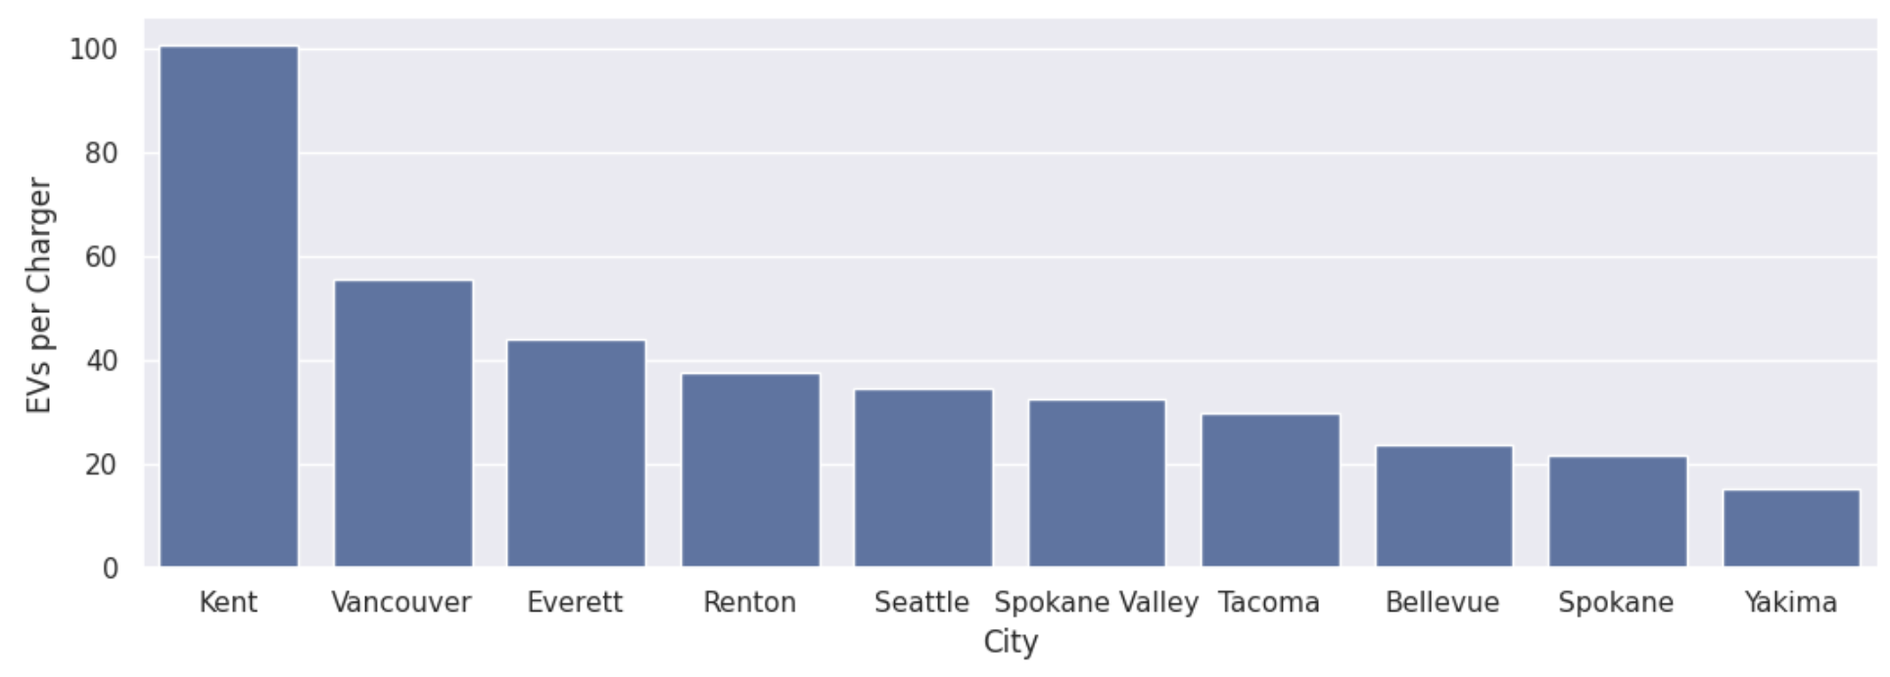
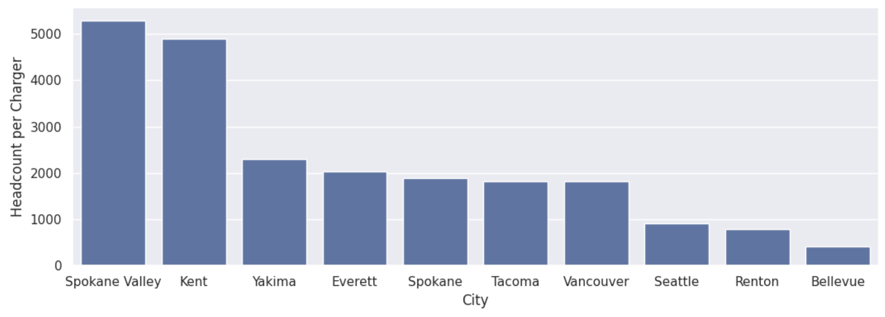
Recommendations
Top 10 cities for ‘EVs per Charger’ based on population
Top 10 cities for ‘Headcount per Charger’ based on population
Noting, per research, an ideal ratio of 8-12 EVs per charger.
Rationale for prioritizing present growth
—>
Rationale for prioritizing future growth
—>

Slide 8
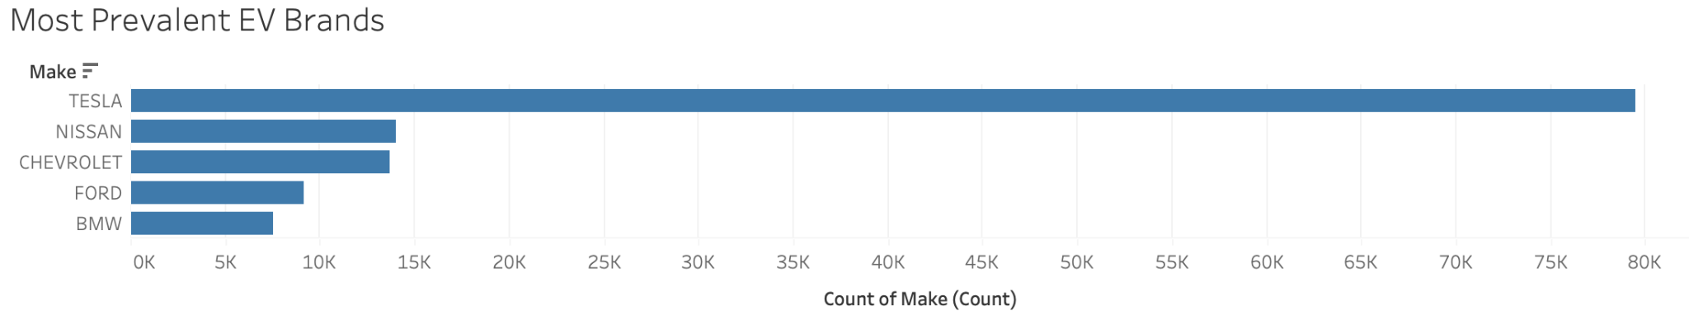
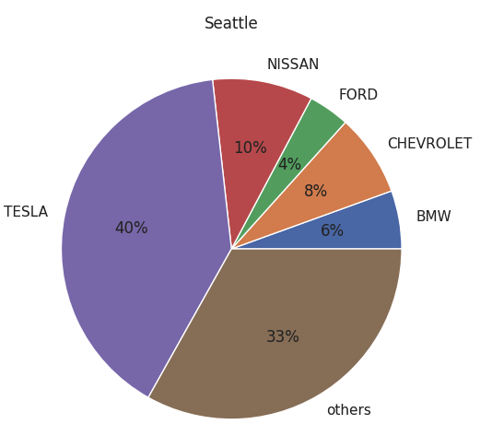
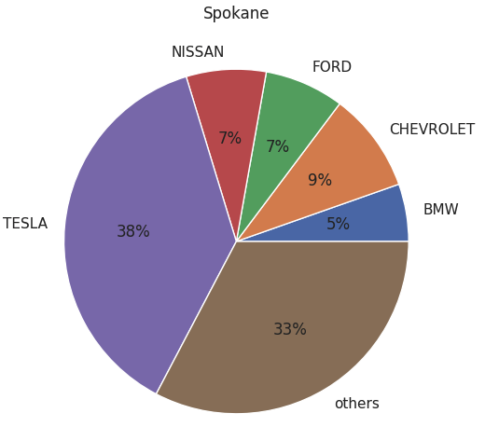
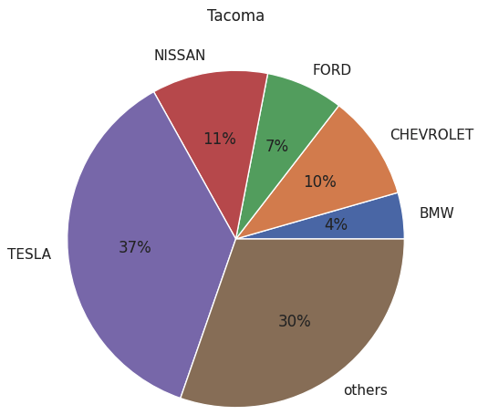
Recommendations
Build infrastructure for the most prevalent brands to ensure compatibility of chargers with the vehicle make.

Slide 9
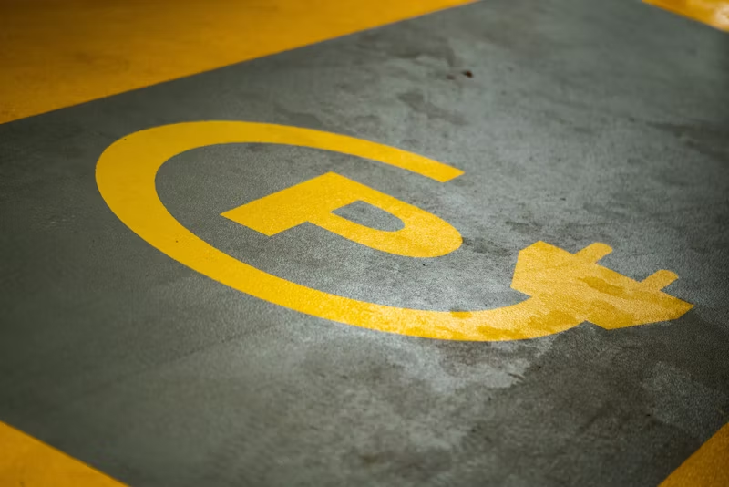
Challenges
Data Source: Lack of supplementary data sources for supporting data points and building the storyline.
Data Cleaning: We came up with creative workarounds for quickly cleaning data and dropping columns using Google Sheets.
Geostatistical Analysis: As resources and skills were very limited, we simplified the scope of the geostatistical analysis to focus on essential insights that can still inform decision-making.
Dashboard Creation: The dashboard was built on Tableau and it was a major challenge to publish and publicly share the dashboard. After a lot of troubleshooting and trial & error, we figured out the best way to go about this.

Slide 10

Thank You
Any Questions?

